Slide 1

Flight Delays Prediction
Datasci-261-team-7-1
Zukang Yang, Nishika Abeytunge, Sam Meng, Joey He, Weijie Yang

Slide 2
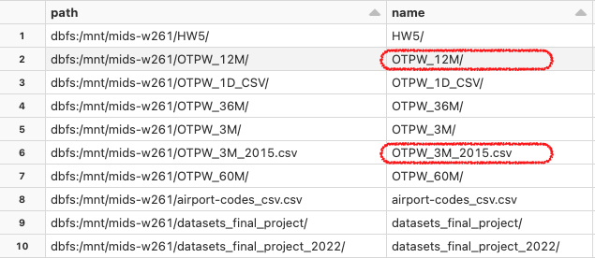
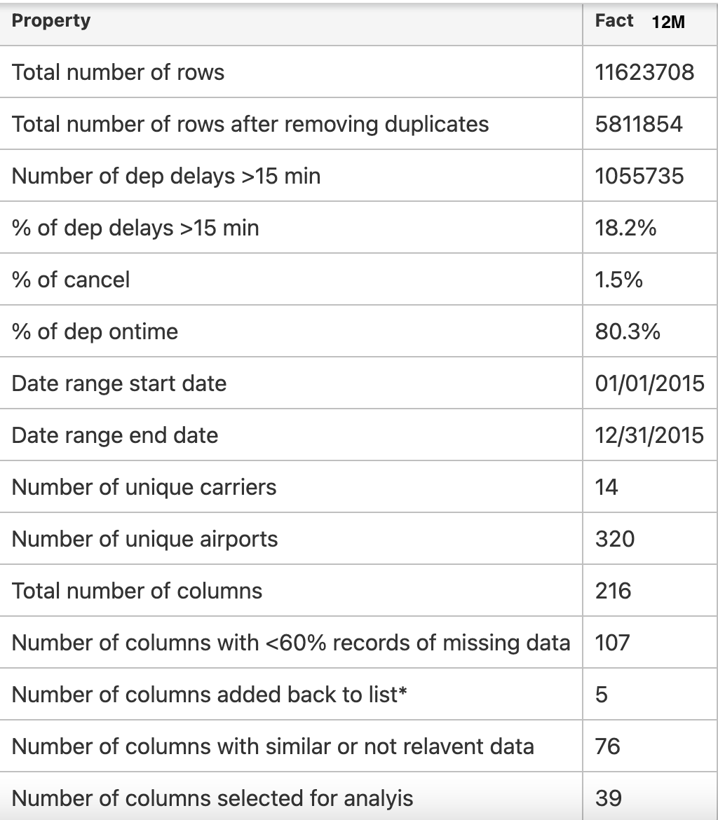
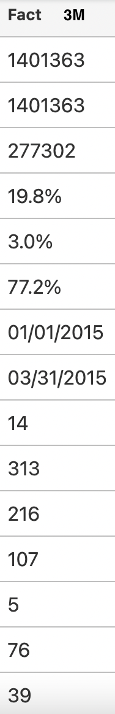

Exploratory Data Analysis (EDA)
Target Variable - DEP_DEL15
'CARRIER_DELAY','WEATHER_DELAY','NAS_DELAY','SECURITY_DELAY','LATE_AIRCRAFT_DELAY'
Notes:
Let’s look at how we did the exploratory data analysis first. we are given with 10 datasets. We used the joined weather and airline dataset for our analysis and I have highlighted those in this list. First, analysing 3m data gave the flexibility in handling relatively low volume of data and determining what approach is the best.then we moved to 12 month dataset.
Table on right shows a summary of the two datasets. Importantly, though there were no duplicates in 3m data there were 50% duplicated in records in 12 month dataset. We dedupe those records before the analysis. There were 109 columns that contained null values in more than 60% of it. We decided to drop those columns, however 5 columns showing on left were added back due to two reasons, One reason is that they may contain useful information. Second is that there is data in these column only if there were delays in these categories. So 60% rule is not necessarily applicable with that.
We decided DEP_DEL15 is as our target variable. This column indicate 1 if the flight was delayed by 15 min or more, and 0 , otherwise.

Slide 3
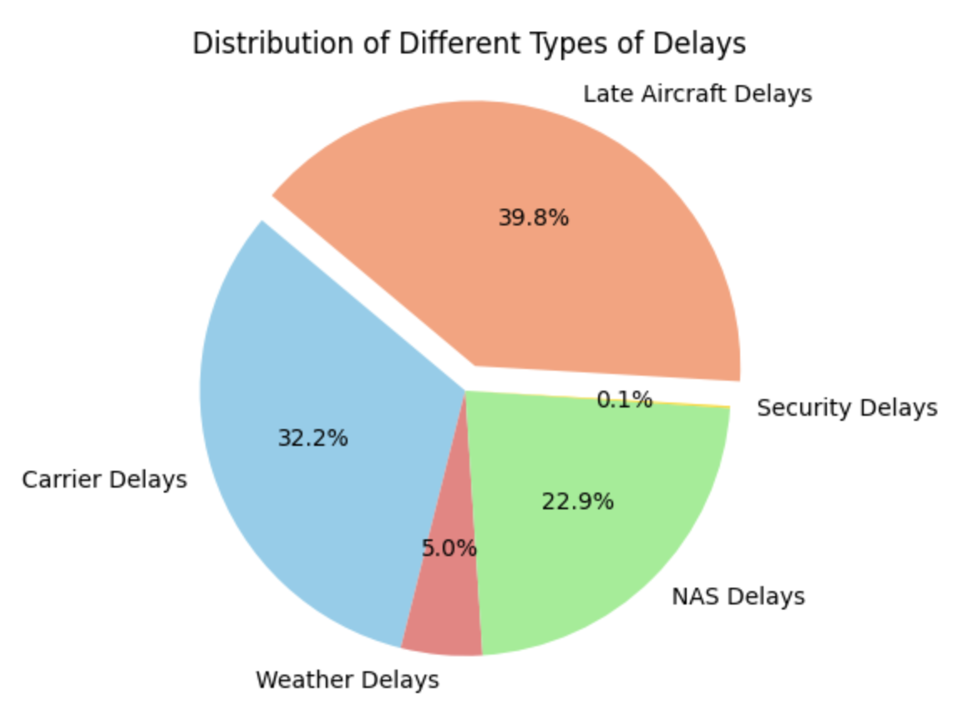
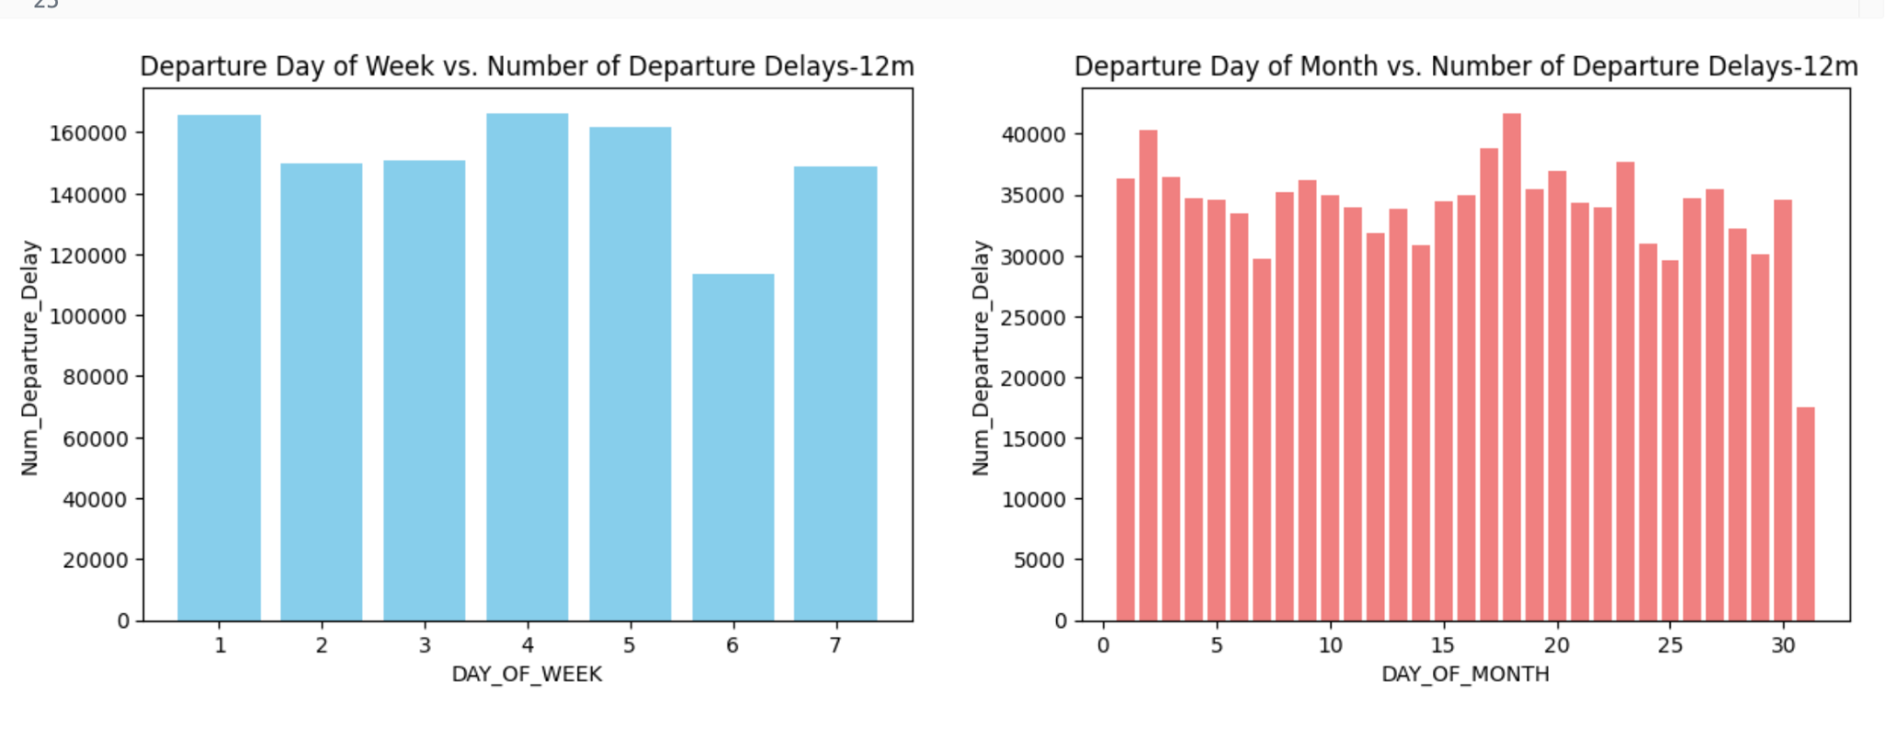
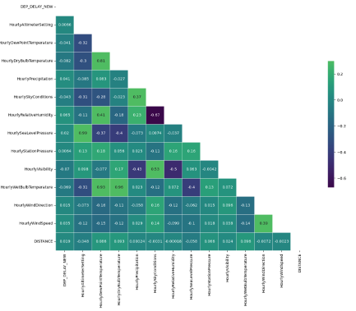
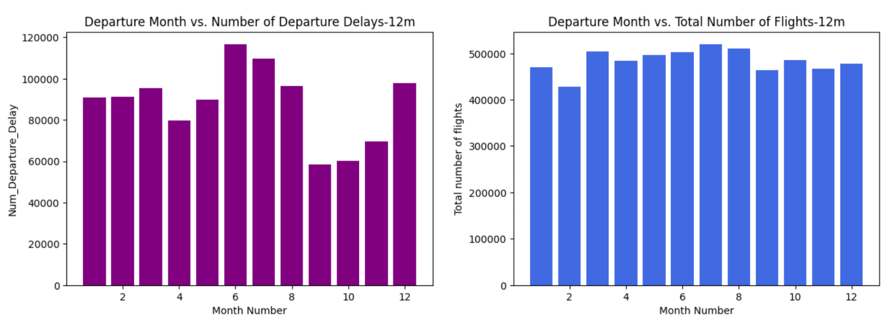
Exploratory Data Analysis (EDA)
Notes:
Pie chart is showing the different types of delays in the dataset. Most of the delays are resulting from late aircraft arrivals. Which is also a snowball effect if the aircraft is delayed due to any other reason it will affect the next trip planned. So each of these other delays get aggregated there.
Periodic relationships are showing in the 4 barcharts in the left side. Last chart is the total number of trips. Only significant callout can be the month of travel. The correlation graph below is showing that there is no significant delays affected mainly due to the weather conditions. However these slight changes can be taken into consideration in our machine learning model much better than human eyes.
So let's move in to the feature selection. .

Slide 4







Feature Preparation & Selection - Basic Features
20 total features used
7 categorical features
13 numerical features (2 time-based features created)
“1” representing delays exceeding 15 minutes
“0” representing delays not exceeding 15 minutes or no delays happen.
DEP_DEL15 as Label (Y)
Flight Factor
Climate Factor - Hourly
Distance Numerical
Taxi out time Numerical
Origination Categorical
Destination Categorical
Carrier No. Categorical
Flight Date Categorical
Longer Taxi out time will take more time and result in higher prob. of delays
Dew Point Temperature Numerical
Precipitation Numerical
Pressure Change Numerical
Relative Humidity Numerical
Sea Level Pressure Numerical
Visibility Numerical
Wind Direction Numerical
Wind Gust Speed Numerical
Wind Speed Numerical
Huge Pressure Change also contributes to flight delays
Basic Factors Selected
Carrier is one of the Flight Delay reason (EDA result)
Temporal Factor
Bad visibility might contribute to flight delays
Month Categorical
Day of Month Categorical
Day of Week Categorical
June ~ August might have more delays than other months (EDA result)
Notes:
Speaker Notes - Weijie
—-------------------------------------------
Now let’s have a look on feature preparation and selection part. In this part, I will introduce what features we selected for subsequent modeling as well as our target.
In total, we selected 20 features. 7 categorical features and 13 numerical features, in which 2 features are time-based features we created based on the source dataset.
Our target, you can see here is “Departure Delay 15 minutes”, which is a binary factor. 1 represents it is a delay record as the delay time exceeds 15 minutes and 0 means it is not a delay record as the delay time does not exceed 15 minutes or no delay happens.
Below part shows the breakdown of the features. In all, we classified selected features into 3 categories:
Flight factor. Factors under this category are related to the flight itself, including distance, taxi-out time, origination, destination, carrier and flight date. Distance and Taxi-out time are numerical and remaining factors in this group are categorical.
Temporal factor. These factors are related to date. Based on our EDA, we clearly know that flight delays have time-clustering effect. Therefore, we incorporate month, day of month and day of week in this category. All of them are categorical.
The third category is Climate factor. These factors are evaluated for the flight conditions. They will have great impact during the flight and contribute to the delays. We take hourly frequency features, including temperature, precipitation, pressure chance, humidity, sea level pressure, visibility, wind directions, wind gust speed and wind speed. All of them are numerical features.
To better understand how these features can potentially contribute to the delays. I posted some examples here to brief the logics.
It is obvious that longer taxi-out time will potentially lead to delays as it might take more time as planned.
Pressure change during flight may also deteriorate the flight conditions and increase delay probability. Bad visibility also contribute negatively to the flight time.
Based on EDA result, the pie chart Nishika shared with us before, carrier is also responsible for delays to some degree.
Based on the information from time-clustering effect, we expect that June to August might have more delays than other months.

Slide 5

Feature Preparation & Selection- Time-based Feature
RFM stands for Recency, Frequency, and Monetary Value, which is a marketing analysis technique used to segment and target customers based on their transaction history. In our project, we introduced this concepts to create time-based features to enrich the feature data.
Take 'carrier' as the object to generate time-based features. The time interval we set is one month.
Recency
Frequency
Monetary
RFM
Example: How recent was the last flight delay for the same carrier with the same origin and destination
Example: How frequent the flight delay was per month for the same carrier with the same origin and destination
Example: What is the total flight distance per month for the same carrier with the same origin and destination
Current Delay Time - Previous Delay Time = Delay Recency ( Delay recency is summarized in days)
Summarize the number of delayed flights per month given group by carrier, origin and destination
Summarize the distance for each flight per month group by carrier, origin and destination
Feature Engineering and select time-based features above
Notes:
Speaker Notes - Weijie
—-------------------------------------------
Besides these features, in order to enrich our features and render the model to extract more information to learn, we created more features based on raw dataset. We here introduced RFM model to create time-based features.
RFM stands for Recency, Frequency, and Monetary Value, which is a marketing analysis technique used to segment and target customers based on their transaction history. In our project, we introduced this concepts to create time-based features to enrich the feature data.
Here, we take “Carrier” as the object to generate time-based features and we set the time interval as one month. For each ratio, we showed an example.
First is recency. We hope to know how recent was the last flight delay for the same carrier with the same origin and destination. Numerically, we generate the days by subtracting current delay flight date with previous delay flight date and we take days as the outcomes. This feature would be useful as it tells the model time patterns for delays
Frequency here is to know how frequent the flight delay was per month for the same carrier with the same origin and destination. Literally, it is the number of delay flights per month group by carrier, origin and destination. The feature can tell the model delay flight frequency, better understand the time-clustering effect.
Next is Monetary, in our project, we can define monetary as the flight distance. What is the total flight distance per month for the same carrier with the same origin and destination. Technically, we summarize the distance for each flight per month group by carrier, origin and destination.
Finally, we need to perform selections on these time-based features and data engineering part before modeling.

Slide 6
Feature Engineering
Hour at which a flight takes off
Certain hours of a day tend to have more delays than others
Two time-based features (RFM)
Recency
How recent was the last flight delay for the same carrier with the same origin and destination
Frequency
Relative frequency of delays for the same carrier with the same origin and destination in the past 30 days

Slide 7
Data Transformation
Imputation
Filled missing numerical values with the median of the feature
Filled missing categorical values with “NA”
Min-max scalar
Ensured all features on the same scale of [0, 1]
One-hot encoding
For nominal categorical features
PCA
One-hot encoding resulted in ~600 features, which makes dimensionality reduction necessary
Train-test Split
Train: first 3 quarters
Test: last quarter

Slide 8
Machine Learning Pipeline
Logistic Regression for binary classification.
Time-series K-fold cross validation for hyper-parameter tuning
Split the training set into K folds.
At each K_n fold, combine the previous K_1, …, K_(n-1) fold as training data to predict on the K_n fold data.
Evaluated with Accuracy, Recall, Precision and F1-score.
Evaluated on last quarter of the 12-month OTPW dataset.
Precision is most important because
False positive is more costly
We don’t want to inform passengers that the flight will be late, causing them to arrive late at the airport, yet the flight arrives on time.

Slide 9
Performance Report
AUC | 0.676
Accuracy | 0.839
Precision | 0.839
Recall | 0.999
F1 | 0.766

Slide 10
Next Steps
More thorough EDA
More feature engineering
Rigorous feature selection with regularization, etc
Create more models against the baseline
Random forest
Xgboost
Multi-layer perceptron
Possibly ensemble models
Final presentation / Report

Slide 11
References
R. Nigam and K. Govinda, "Cloud based flight delay prediction using logistic regression," 2017 International Conference on Intelligent Sustainable Systems (ICISS), Palladam, India, 2017, pp. 662-667, doi: 10.1109/ISS1.2017.8389254.
Yuemin Tang. 2021. Airline Flight Delay Prediction Using Machine Learning Models. In 2021 5th International Conference on E-Business and Internet (ICEBI 2021), October 15-17, 2021, Singapore, Singapore. ACM, New York, NY, USA, 7 Pages. https://doi.org/10.1145/3497701.3497725
"RFM Analysis - Understanding Customer Behavior" by SuperOffice: https://www.superoffice.com/blog/rfm-analysis/
"RFM (recency, frequency, monetary) analysis" by IBM: https://www.ibm.com/cloud/learn/rfm-analysis

Slide 12
Thank You!

